Slide 1
Understanding and Using the tracert Command
A guide to network path tracking
By Sam Mendez
Csia 330 Wireless security

Slide 2
What is tracert?
Tracert (Trace Route) is a command-line tool that maps network packets take to a destination
It helps identify where the delays or failures occurs in a network connection
Each step in the route is called a hop, representing a router or network device.

Slide 3
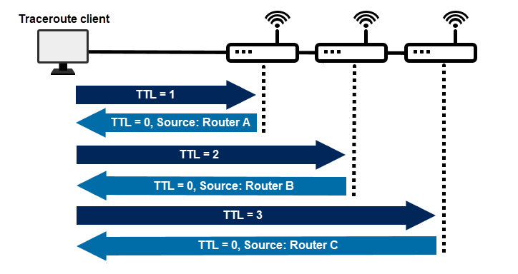
How tracert Works

Slide 4
Understanding the Output
A tracert out put contains:
Hop number – Steps in the route
Response Times (ms) – Shows delay per hop
Router IP or Hostname – Identifies each network device
* * * Timeout – A router is blocking responses or there is a failure

Slide 5
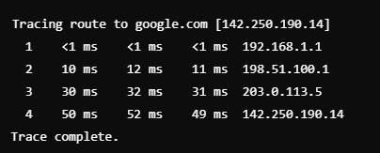
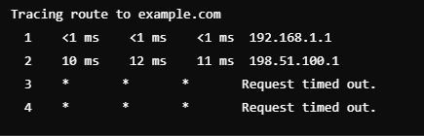
Example Outputs
Normal Output
Problematic Output

Slide 6

When to Use tracert
Troubleshooting slow internet – identify network delay
Detecting ISP issues – Find slow or unresponsive servers
Diagnosing routing failures – Determine if a website is unreachable
Comparing different networks – Test speed and paths across connections

Slide 7
Troubleshooting with tracert
Diagnosing Network problems with tracert
Timeouts (* * *) – May include
A firewall blocking traffic
A router issue or offline server
High latency (long response times) – Could mean
Network congestions or an overloaded router
ISP issues affecting connection speeds
Failed hops beyond your ISP – Likely a problem with the website’s network

Slide 8
Conclusion
Key takes aways:
Tracert helps map network paths and diagnose slow connections
Each hop represents a step in the data journey
High latency and timeouts can indicate network issues

